Slide 1
Predicting Recipe Popularity for Increased Traffic
A Data-Driven Approach to Homepage Curation

Slide 2
Project Overview & Business Goal
Business Goal: Help the product team identify which recipes will generate high traffic when displayed on the homepage, to increase website traffic by up to 40% and drive subscriptions.
Our Objective: Predict whether a recipe will have 'High' traffic.
The Ask: Correctly predict high-traffic recipes 80% of the time. This is our key business metric.

Slide 3
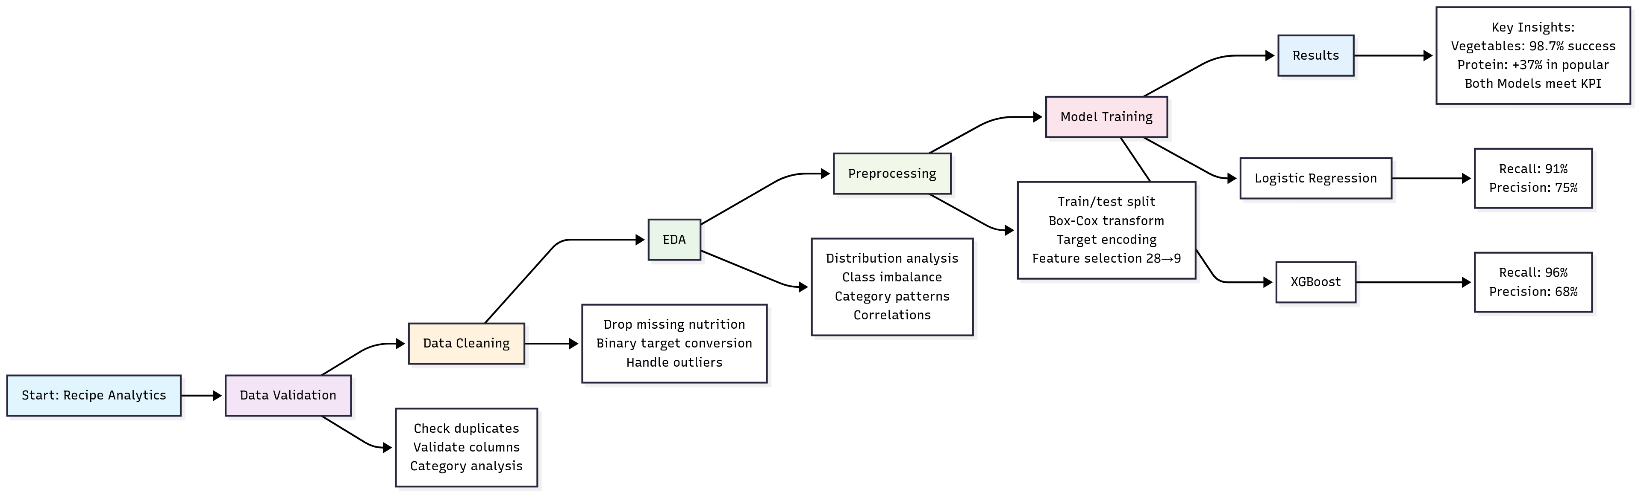
How We Tackled the Problem
Workflow:
Data Validation
Data Cleaning (895 recipes retained)
EDA (relationships between features & traffic)
Feature Engineering (Preparation, Extraction, Selection)
Model Development (Logistic Regression & XGBoost)

Slide 4
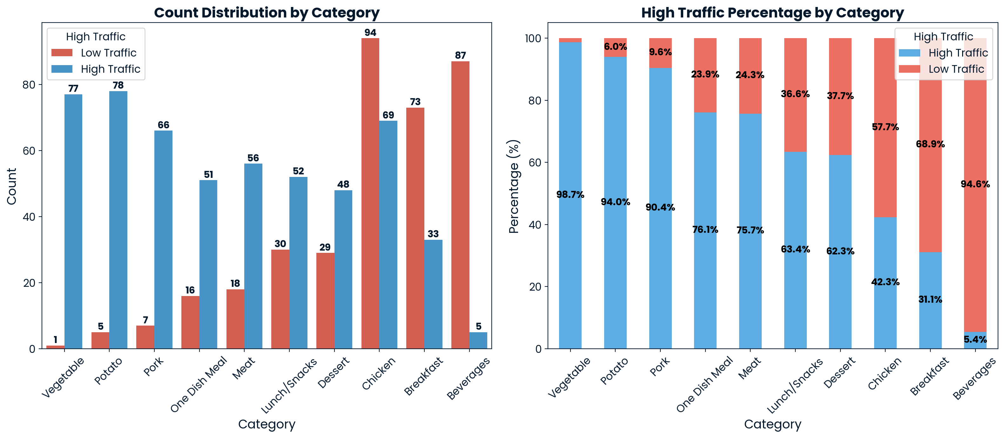
Key Findings: Category is the Strongest Predictor
Vegetable recipes are almost always successful (98.7% high traffic).
Beverages are rarely popular (5.4% high traffic).
Recommendation: Prioritize vegetable-based recipes and de-prioritize beverages on the homepage.

Slide 5
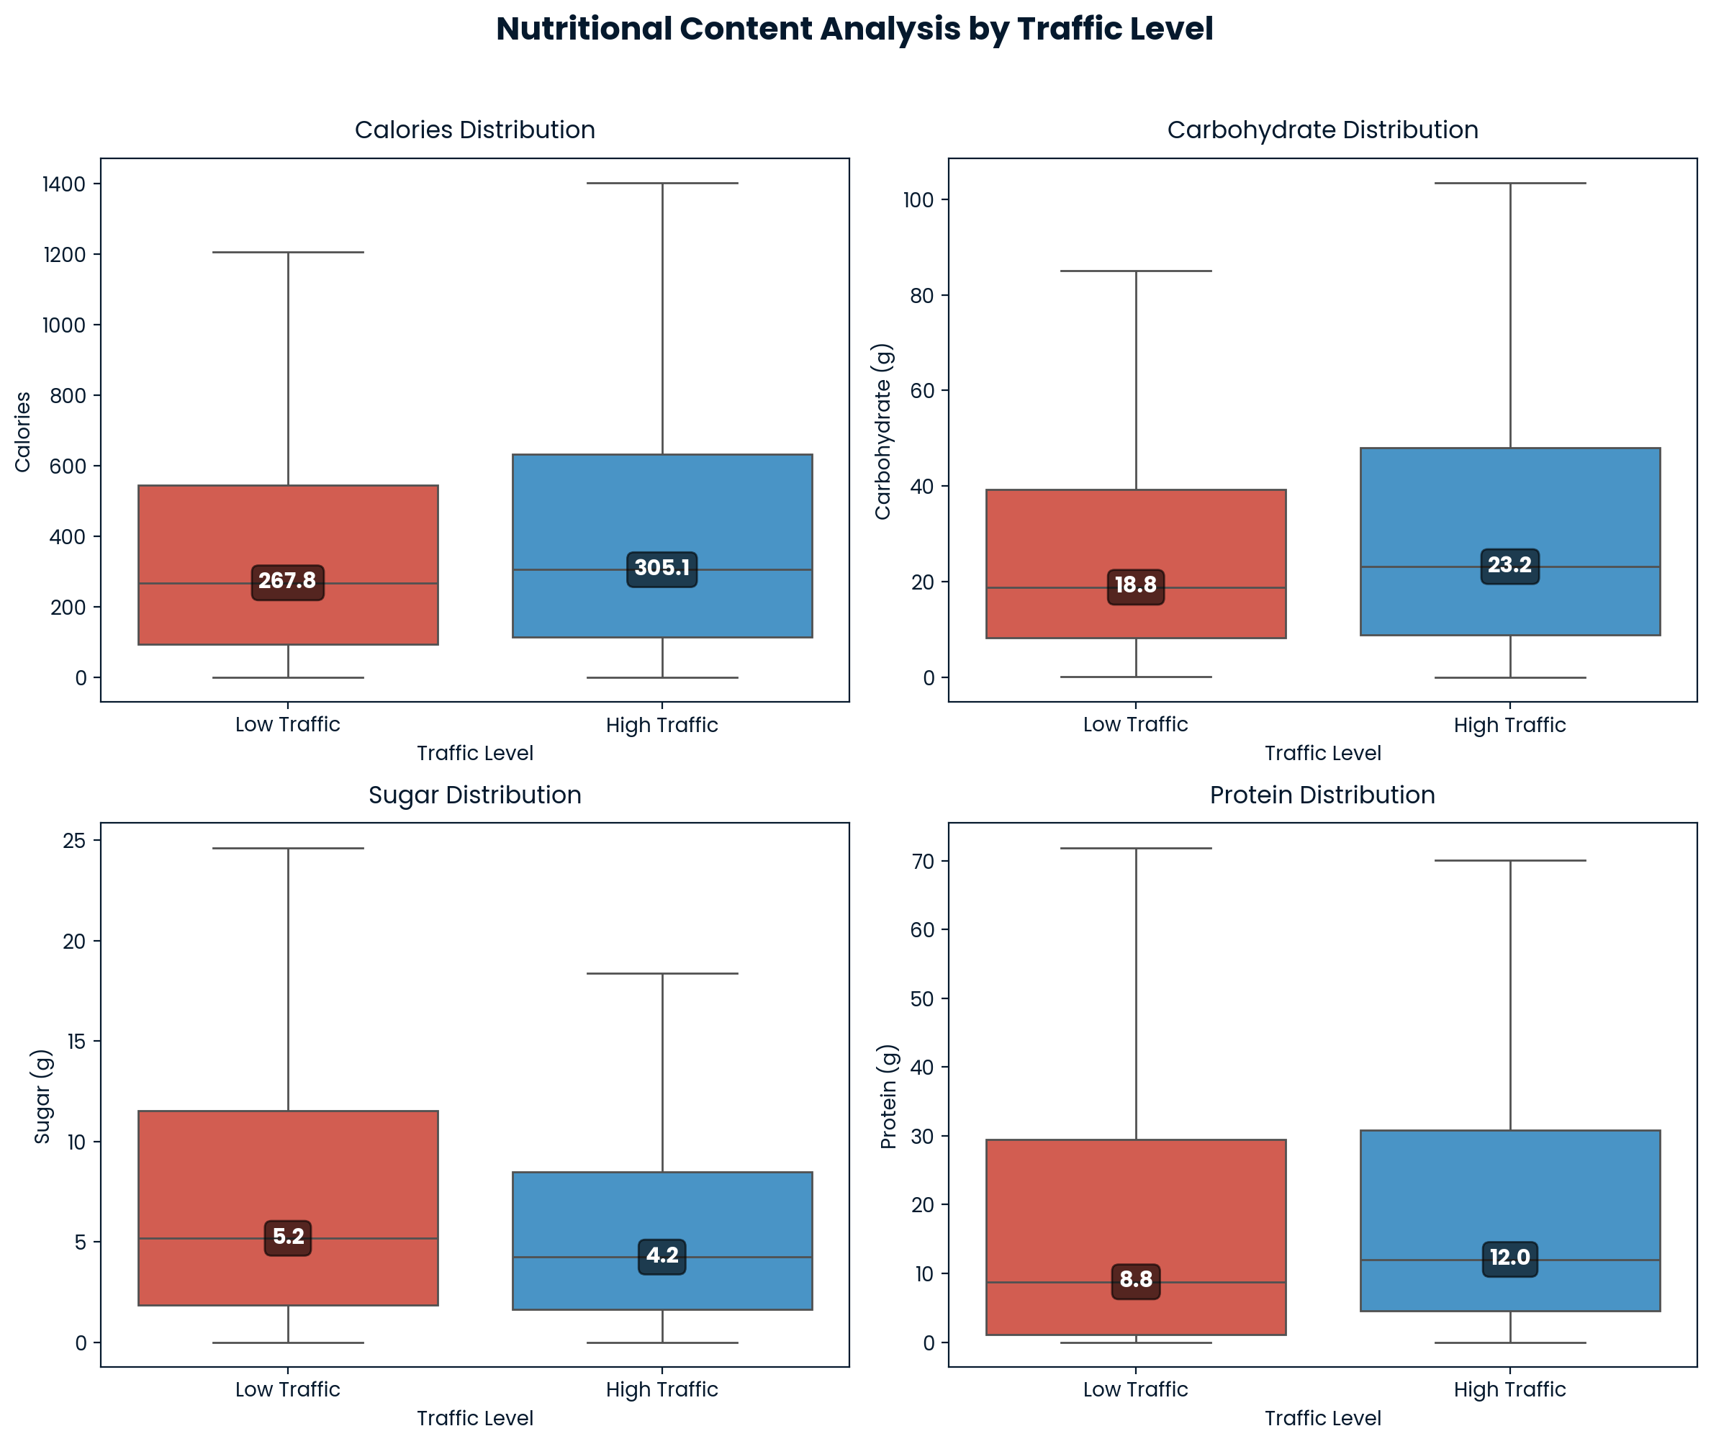
Key Findings: Nutritional Drivers
Protein: +37% in popular recipes
Carbs: +23%
Sugar: -18%
Serving size is not a meaningful predictor
Recommendation: Focus on protein-rich, balanced meals.

Slide 6
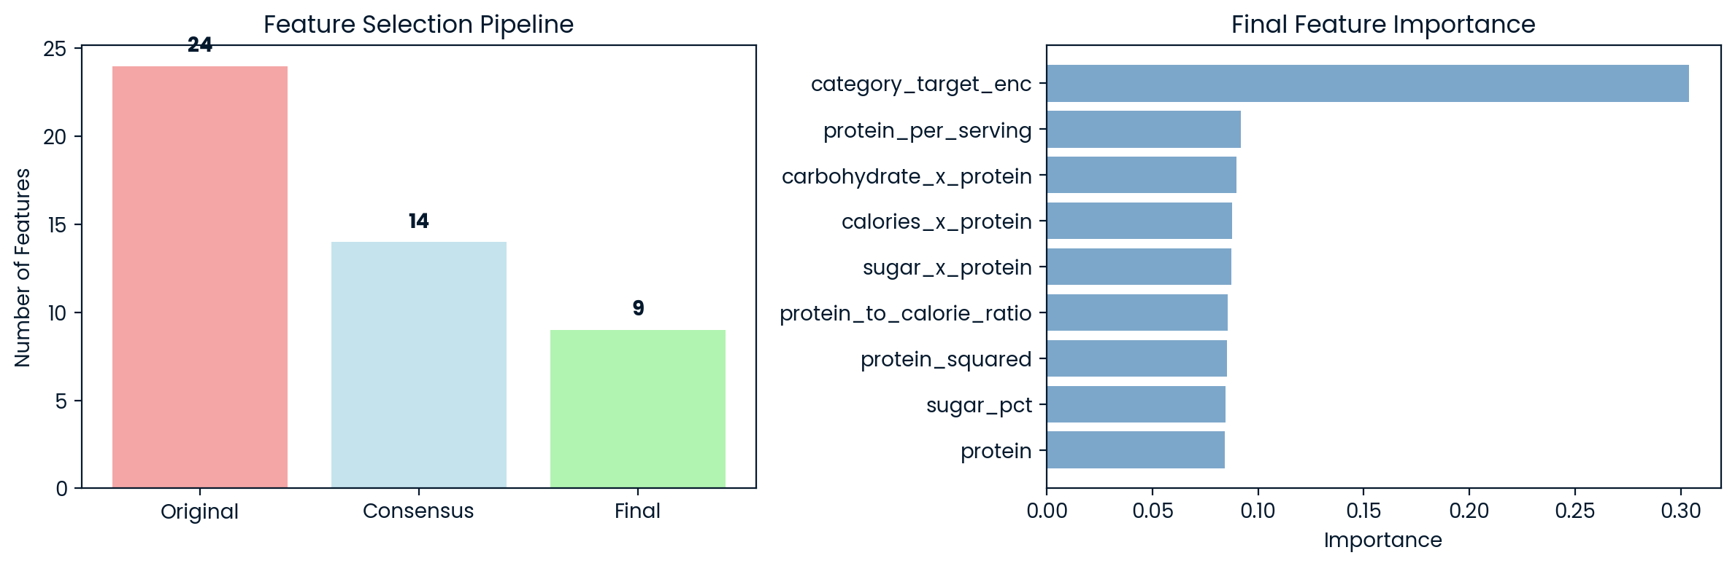
Key Findings: Interactions Matter
Complex carb is more popular than sugars
People prefer recipes that combine both carb and protein
Protein is Pivotal: 67% of selected features involve protein
Interaction features are highly predictive.

Slide 7
Our Business Metric: Recall
Our primary business metric is Recall for high-traffic recipes.
This metric answers the question: 'Of all the high-traffic recipes, what percentage did our model correctly identify?'
The business goal is to achieve a Recall of at least 80%.
We compared two models: a simple Logistic Regression baseline and an advanced XGBoost model.

Slide 8
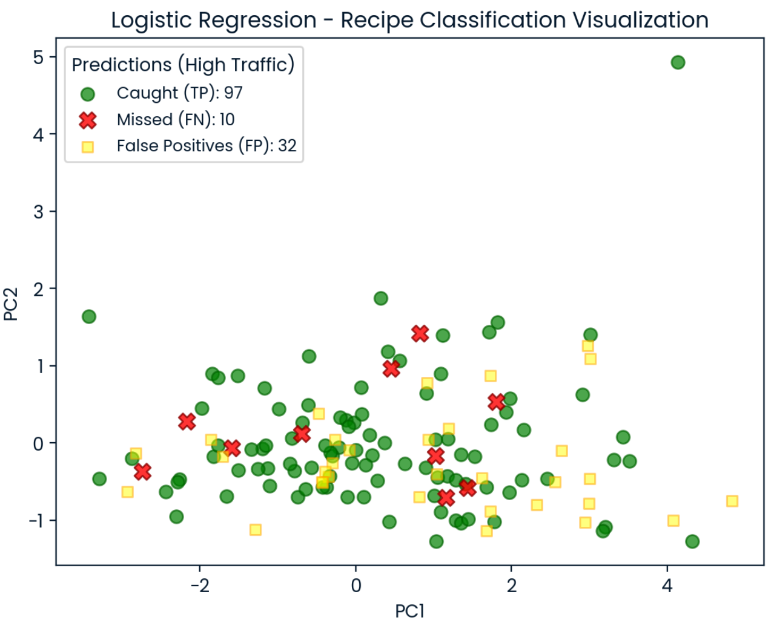
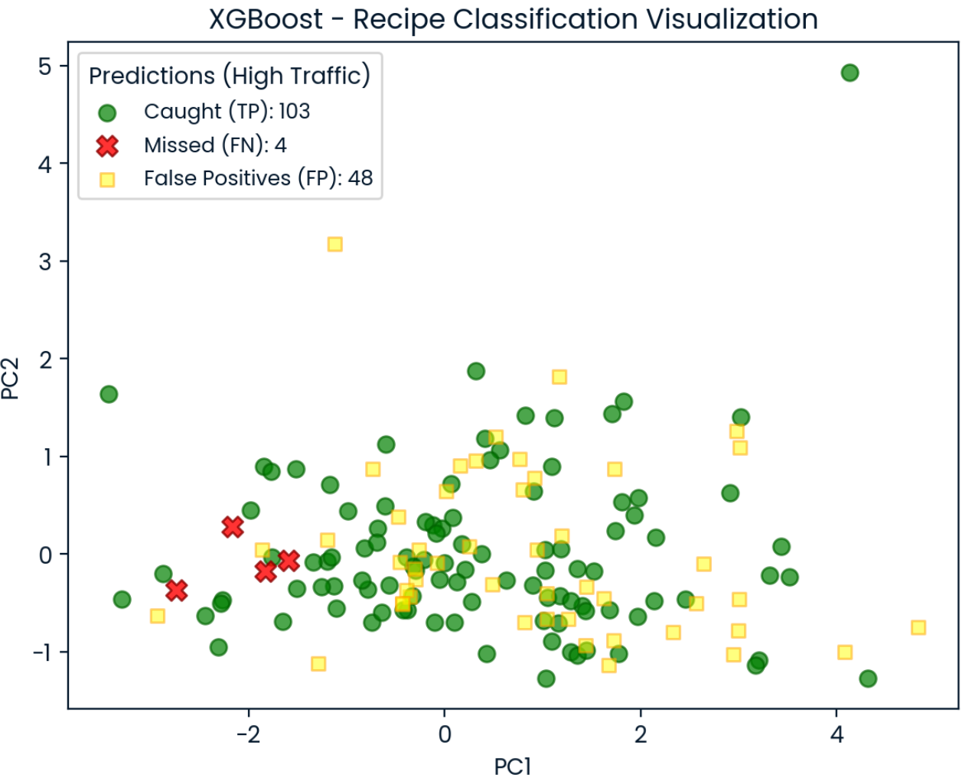
Model Performance: Meeting the KPI
1. Logistic Regression:
Recall: 91% | Precision: 75% | F1: 82%
2. XGBoost:
Recall: 96% | Precision: 68% | F1: 80%
Both exceed the 80% Recall target , but they offer different trade-offs between catching all popular recipes and avoiding mistakes.

Slide 9
Recommendations for the Business
Homepage curation :
Prioritize vegetable & protein-rich recipes.
Avoid beverages (weak performance).
Model deployment:
If the top priority is to never miss a high-traffic recipe: Use XGBoost.
If homepage slots are limited and accuracy matters more: Use Logistic Regression.
If neither of the above applies: Start with Logistic Regression, then run A/B tests with XGBoost to measure gains from higher recall.
Prioritize balanced-carb recipes (Complex Carbs > Sugar)

Slide 10
Monitoring & Next Steps
Monitoring:
Track Recall (primary), Precision, F1 weekly.
Ensure precise labeling to strengthen model signals.
To Enhance:
Collect more data.
Complete the missing features for the 52 rows .
Expand dataset (user engagement, preparation time).
Clustering: Collect user info to shift from “popular” to “popular for this category of users”
A/B Testing : Compare model-driven selections vs. current curation to measure uplift.

